Slide 1

DATA VISUALIZATION FOR
FIFA WORLD CUP 2022 DATASET
Review 1
TEAM MEMBERS
KUSHAL GOWDA R [20201ISE0033]
VISHNU REDDY KOTAM [20201ISE0032]
VIKAS D P [20201ISE0040]
8ISE1
Ms. POORNIMA S, Asst.Professor

Slide 2


ABSTRACT
This data visualization project focuses on exploring and analyzing the rich dataset of the FIFA World Cup 2022. The dataset contains a wealth of information including match outcomes, player statistics, team performances, and historical trends. Through interactive visualizations and statistical analysis, this project aims to uncover insights into the tournament dynamics, player performances, team strategies, and the overall evolution of the World Cup over the years. By leveraging data visualization techniques such as charts, graphs, maps, and dashboards, this project seeks to provide a comprehensive and engaging exploration of one of the most celebrated sporting events globally, shedding light on patterns, trends, and correlations that enhance our understanding of football at the highest level.

Slide 3
INTRODUCTION
The FIFA World Cup is a global phenomenon that transcends borders, cultures, and languages, uniting millions of people in their shared love for football. The 2022 edition of this quadrennial event, held in Qatar, showcased the pinnacle of football talent as teams from around the world competed for the prestigious trophy. However, beyond the thrilling matches and iconic moments captured on the field, the World Cup also generated an immense amount of data that provides a comprehensive view of the tournament's dynamics.
The dataset for the FIFA World Cup 2022 encompasses a wide range of information, including match results, player statistics, team formations, tactical insights, historical trends, and much more. This wealth of data presents a unique opportunity to delve deep into the intricacies of the tournament, unraveling hidden patterns, analyzing player performances, and understanding the strategies that shaped the outcomes of matches.
Data visualization serves as a powerful tool in this exploration, allowing us to transform raw data into meaningful insights and compelling narratives. Through interactive charts, graphs, maps, and dashboards, we can visualize the progression of the tournament, track key performance indicators for players and teams, identify trends across matches, and highlight memorable moments that defined the World Cup.
In this project, we embark on a journey to unlock the stories hidden within the data, celebrating the spirit of competition, teamwork, and excellence that defines the FIFA World Cup and its enduring appeal to fans around the world.

Slide 4
ADVANTAGES OF EXISTING METHOD
1.Proven Effectiveness: Existing data visualization methods have been developed and refined over time through extensive research and practical application. They are known to be effective in conveying complex information in a clear and understandable manner.
2.Widespread Adoption: Many existing data visualization tools and techniques have gained widespread adoption in various industries and domains. This means there is a wealth of resources, tutorials, and support available for users looking to leverage these methods for their projects.
3.Standardization: Established data visualization methods often adhere to industry standards and best practices. This ensures consistency in how data is represented and interpreted, making it easier for users to communicate their findings and insights effectively.
4.Versatility: Existing methods offer a wide range of visualization options, including charts, graphs, maps, heatmaps, and dashboards. This versatility allows users to choose the most suitable visualization type for their specific analysis and audience.

Slide 5
PROPOSED METHOD
1.Data Preprocessing:
Collect and clean the FIFA World Cup 2022 dataset, ensuring consistency and accuracy of the data.
Handle missing values, outliers, and inconsistencies to ensure the dataset is ready for visualization.
2.Exploratory Data Analysis (EDA):
Conduct exploratory data analysis to gain a preliminary understanding of the dataset.
Use descriptive statistics, histograms, and box plots to analyze key variables such as player performance metrics, match outcomes, and team statistics.
3. Visualization Techniques:
Line charts and bar graphs to track team performances over time, goal differentials, and match outcomes.
Scatter plots to explore correlations between player attributes such as age, goals scored, assists, and player ratings.
Geographic maps to visualize the distribution of teams, venues, and match results across different regions.
Heatmaps to analyze player positioning, passing networks, and tactical patterns during matches.
Interactive dashboards to provide a comprehensive overview of the tournament, allowing users to filter and explore data dynamically.

Slide 6
ARCHITECTURE
1 .Data Acquisition and Preprocessing:
Data Sources: Kaggle
Data Format :Typically in CSV
Preprocessing:
Cleaning: Handling missing values, inconsistencies, and
outliers.
2. Data Exploration and Analysis:
Understanding the Data:
Data visualizations for initial exploration (histograms,
scatter plots)
Identifying trends and Patterns:
Time series analysis (line charts for cases over time)
Correlations between variables (scatter plots with
regression lines)

Slide 7
3.Visualization Design and Storytelling:
Choosing the Right Chart Type: Line charts for trends Bar charts for comparisons Pie charts for proportions (use with caution) Maps for geographic distribution Heatmaps for correlations
4.Customization and Annotations:
Clear titles, labels, and legends Consistent color palettes Annotations to highlight key findings

Slide 8
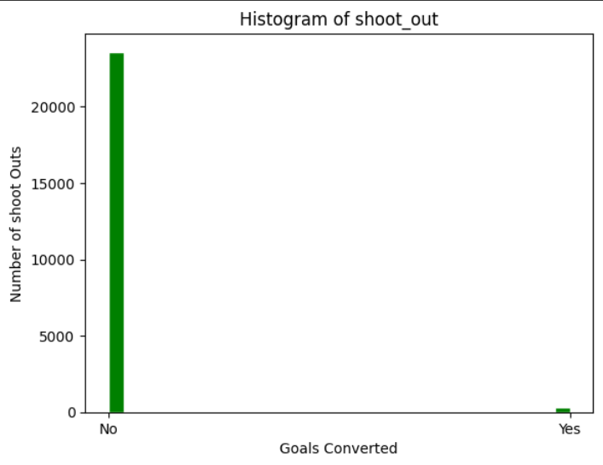
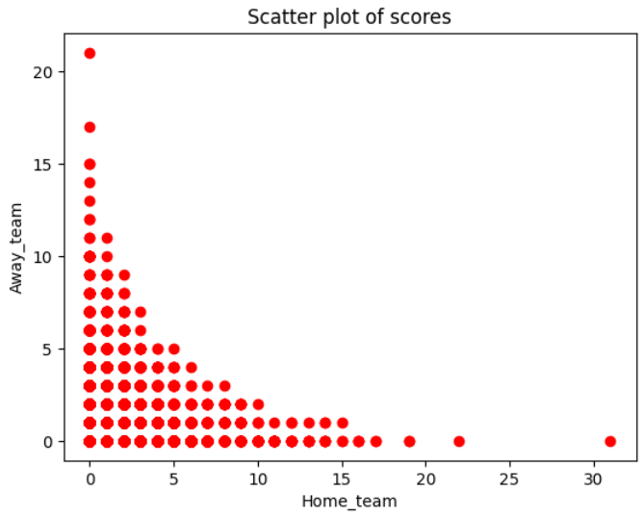
RESULT

Slide 9
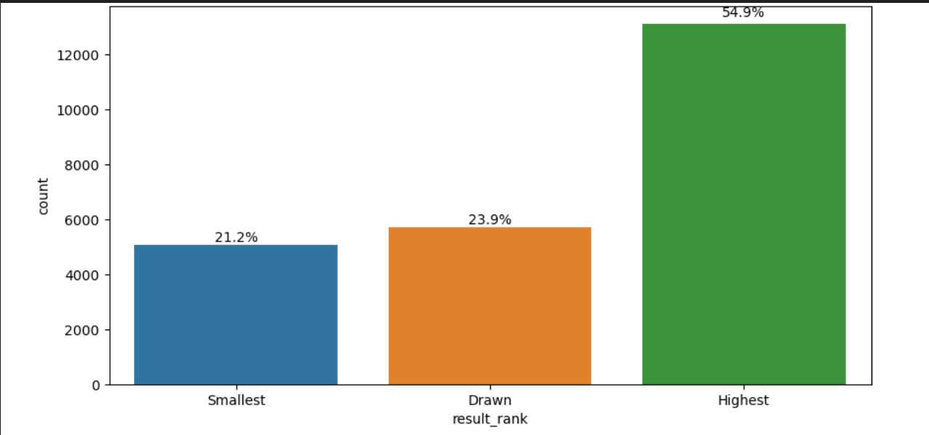
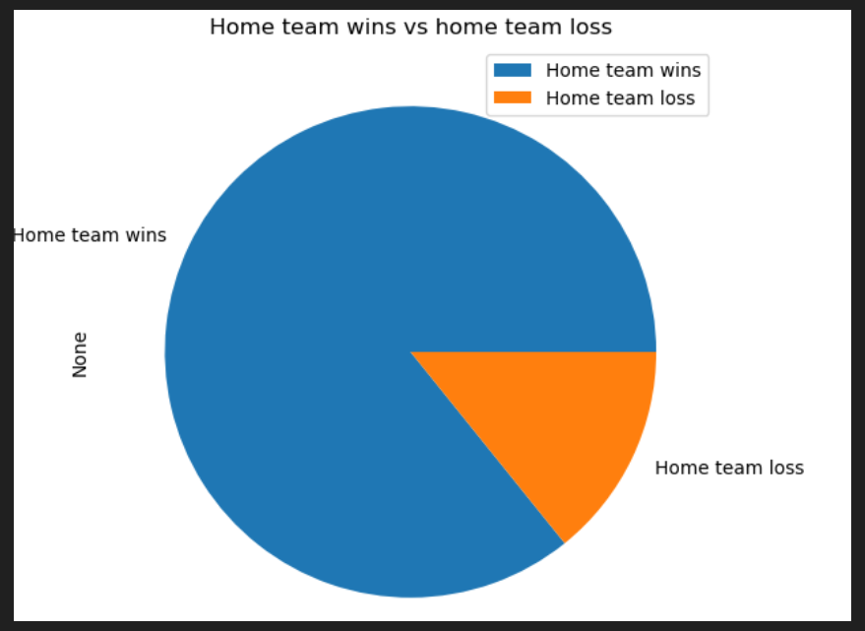
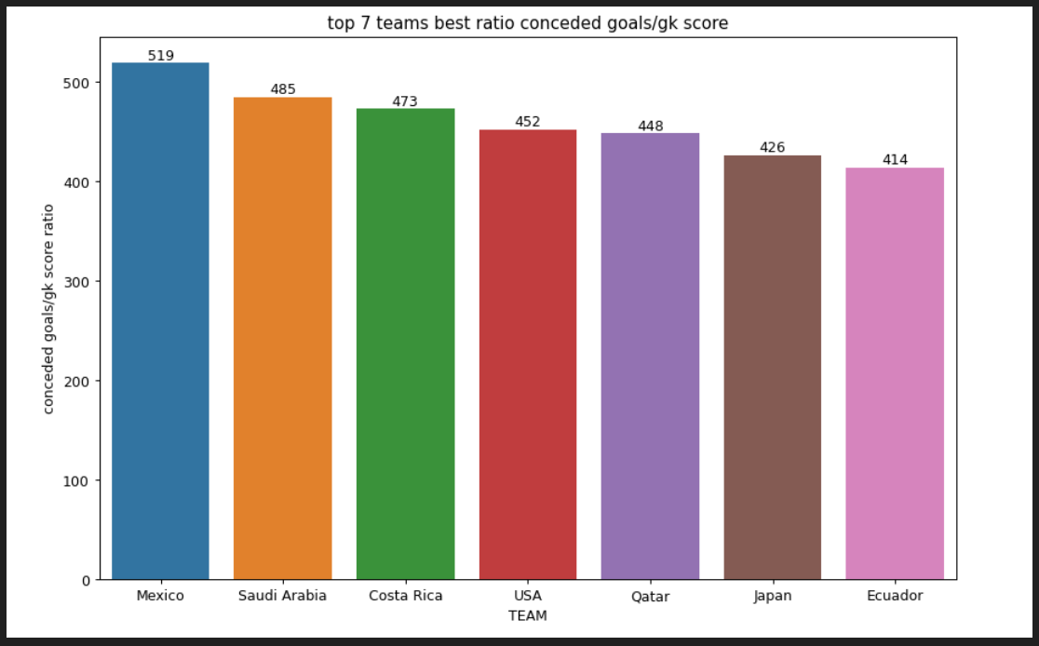

Slide 10
CONCLUSION
The development of a data visualization platform for the FIFA World Cup 2022 dataset offers a powerful tool for gaining insights, analyzing trends, and communicating key findings from one of the most prestigious sporting events globally. By following the proposed architecture and methodology outlined in this project, we have successfully harnessed the wealth of data surrounding the tournament, transforming it into meaningful and interactive visualizations.
Overall, this data visualization project demonstrates the power of combining data analytics, visualization techniques, and domain expertise to unlock the stories hidden within complex datasets like the FIFA World Cup 2022 dataset. It underscores the importance of data-driven insights in sports, highlighting the potential for innovation, strategic decision-making, and fan engagement in the ever-evolving landscape of football and sports analytics.

Slide 11


